Slide 1

AI BASED – DIET AND WORK OUT PLAN GENERATOR
DEPARTMENT OF
COMPUTATIONAL INTELLIGENCE
PROJECT BATCH NO-22
1) .V.SAI VENKAT (22N31A66F9)
2) .SK.IMRAN(22N31A66G2)
3).T.SAI YATHISH(23N35A6618)
GUIDE
Mr. T. Hari Babu
Assistant Professor

Slide 2

AGENDA
ABSTRACT
INTRODUCTION
EXISTING SYSTEMS
PROPOSED SYSTEMS
SOFTWARE REQUIREMENTS
HARDWARE REQUIREMENTS
UML DIAGRAMS
ARCHITECTURE DIAGRAM
REFERENCES

Slide 3

ABSTRACT
“Health Is Wealth” the most known phrase we all are aware about. Nowadays, people tend to eat unhealthy food and their careless behaviour may cause severe diseases. For such cases, more efforts should be made to plan a diet but people are reluctant of consulting a dietitian. Artificial Intelligence is a technology that will help to make interaction between man and machine using natural language possible. It asks all the data from the user and processes it to provide the diet plan to the user. This will help common people to maintain their health in better way with proper guidance.
Builds a balanced meal and workout plan in seconds with this AI-powered diet plan generator.
Generate a budget friendly diet and workouts according to your need.

Slide 4

INTRODUCTION
Now a days it is observed that most of the aged people and even some of the youngsters are suffering from more than one health issue (such as diabetics and BP, thyroid and Gastric problems etc).
For such cases, more efforts should be made to plan a diet but people are reluctant of consulting a dietitian (due to laziness or unawareness).
It would be super simple and comfortable which analyses your health issues and tells you what to eat and what not to. It is also important how you process the food.
In this we can have a complete picture of what all things should be eaten in your diet and what all to avoid.
This can help you in many ways as it is having features with calories intake which healthy diet could make you decrease your problems.
Hence making one aware and motivating to lead a healthier life with a proper personalized diet and workout plan.

Slide 5
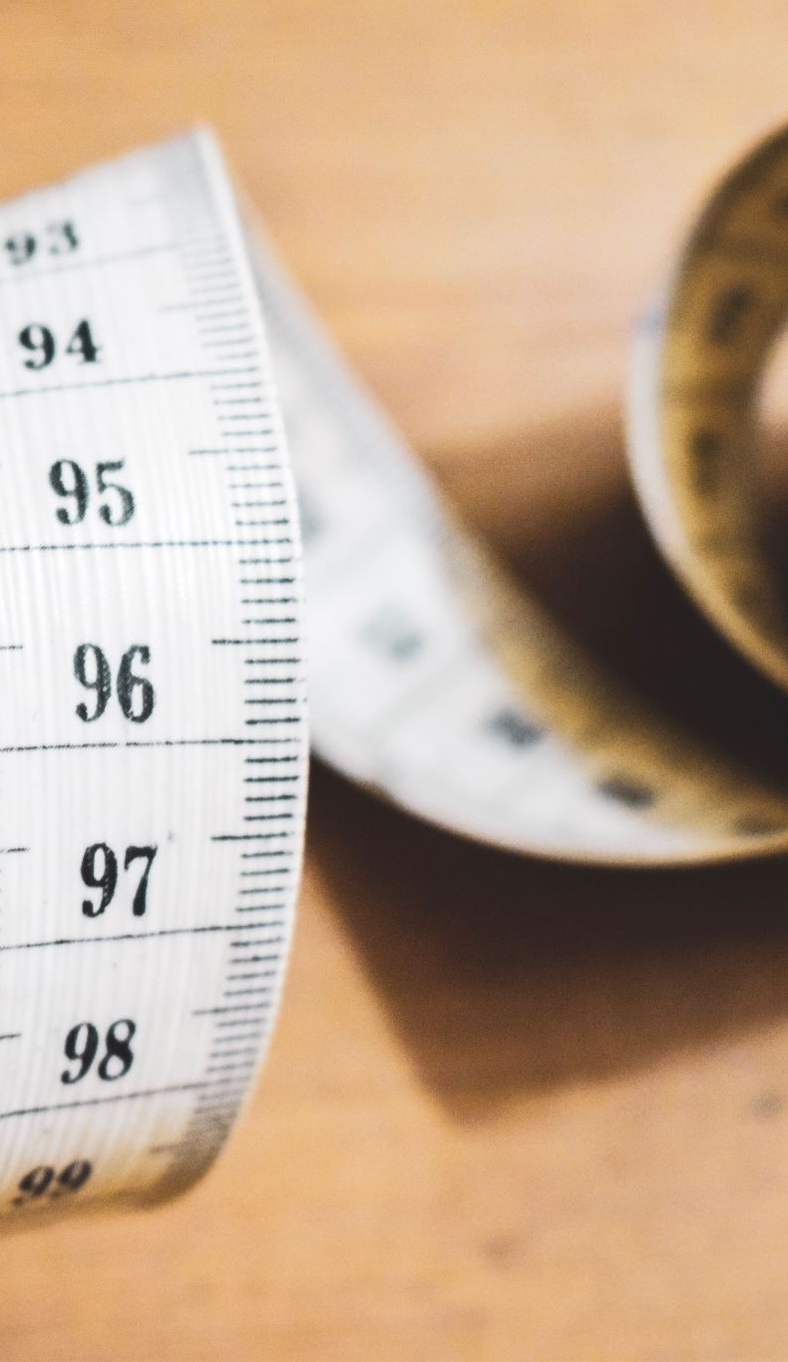
Existing systems
Existing system focuses on one particular issue/requirement such that weight loss/weight gain. Calculates the number of calories that must be taken by the person. Suggests a diet plan for that.
Ex:HealthifyMe, Fitbit
here HealthifyMe & Fitbit gives us the calories count of the food the client consume and help us to take the balanced food and FitBit gives the the count of the client steps and count of the calories decreased.

Slide 6
Existing systems
Existing system focuses on one particular issue/requirement such that weight loss/weight gain. Calculates the number of calories that must be taken by the person. Suggests a diet plan for that.
Ex:HealthifyMe, Fitbit
here HealthifyMe & Fitbit gives us the calories count of the food the client consume and help us to take the balanced food and FitBit gives the the count of the client steps and count of the calories decreased.

Slide 7
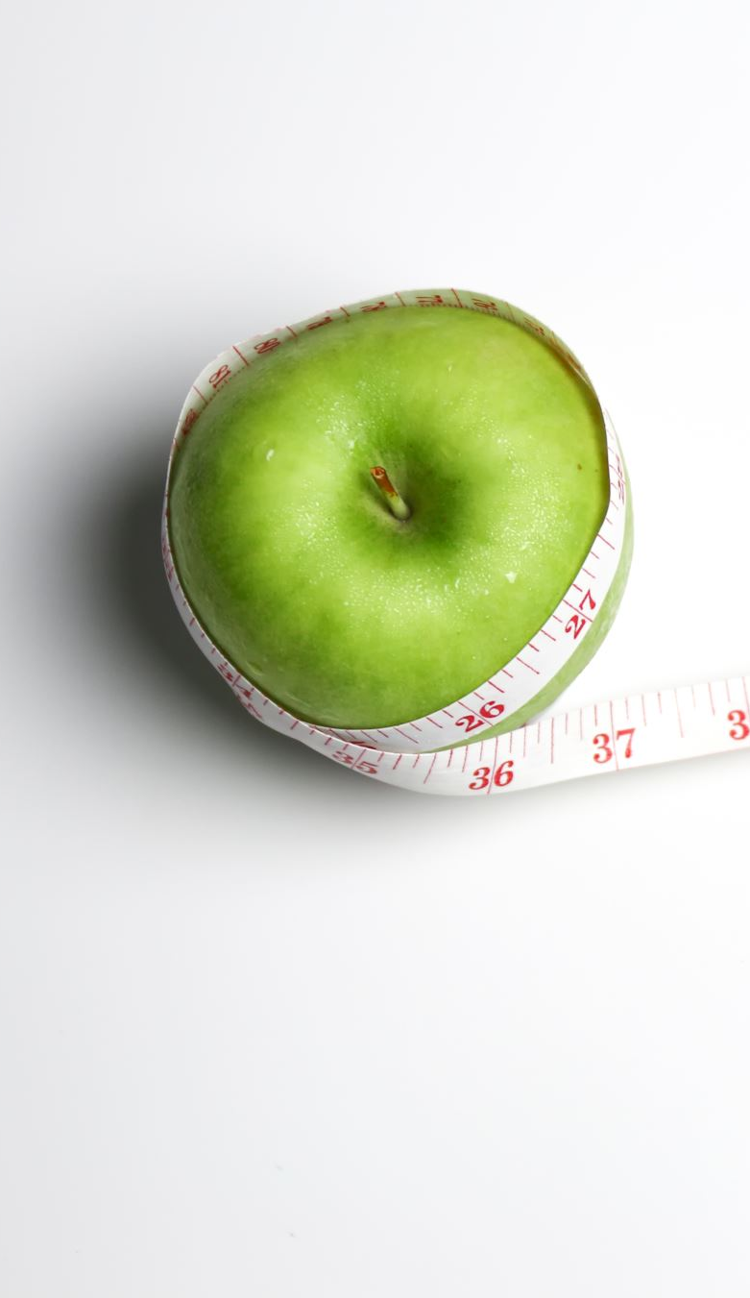
PROPOSED SYSTEM
Provides dietary assistance to the users and helps the users to control their hunger issues and maintain their diet properly. Any age group can use this application. Through BMI this application is used. BMI is calculated with the help of user’s height, weight, gender and their daily activity. This application helps the user to have a good and healthy diet with protein ingredients.
It's crucial to note that any AI-based system should be designed with user safety and well-being in mind, and users with specific health concerns should consult healthcare professionals before making significant changes to their diet or exercise routine.
AI-based diet and workout plan generator involves a combination of machine learning, nutrition science, and exercise physiology. Such a system would need to take into account individual preferences, goals, health conditions, and other relevant factors.

Slide 8
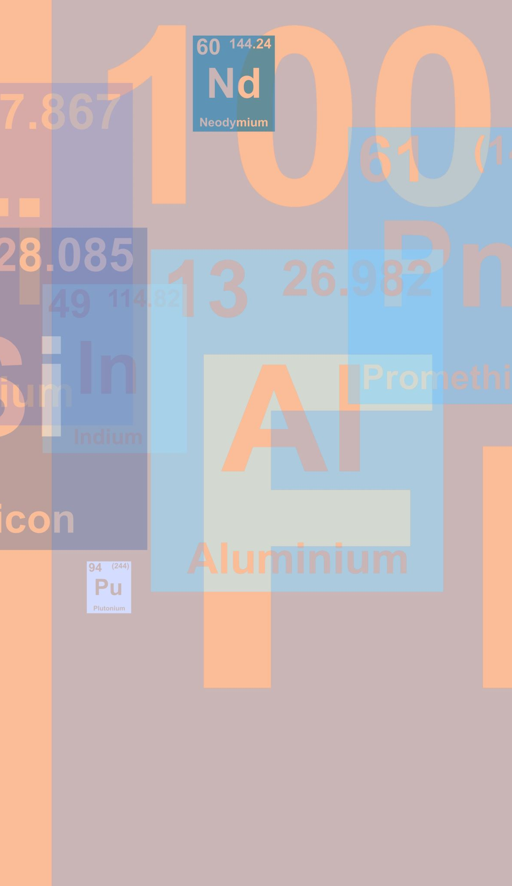
SOFTWARE REQUIRMENTS
Front end: HTML(version 5),Python(version 3.8.2)
Back end: My SQL(version 8.3.0)
Operating systems: Windows xp, mac.(preferred windows 10)

Slide 9

HARDWARE REQUIRMENTS
The following describes the hardware needed in order to execute and develop the Virtual Mouse application:
Personal Computer and Mobile
Processor: i3 ,Android
Main Memory:4 GB RAM
Hard Disk: 512 GB

Slide 10
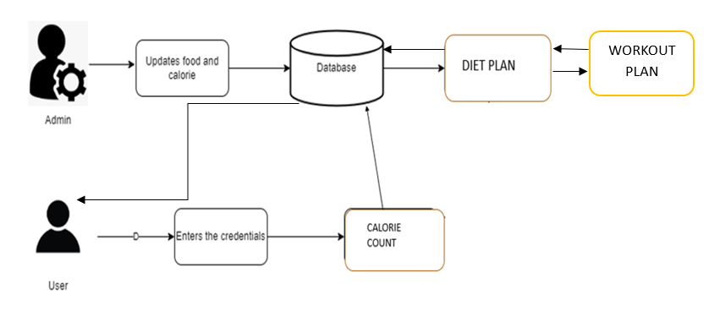
SYSTEM ARCHITECTURE DIAGRAM
Calorie Count

Slide 11
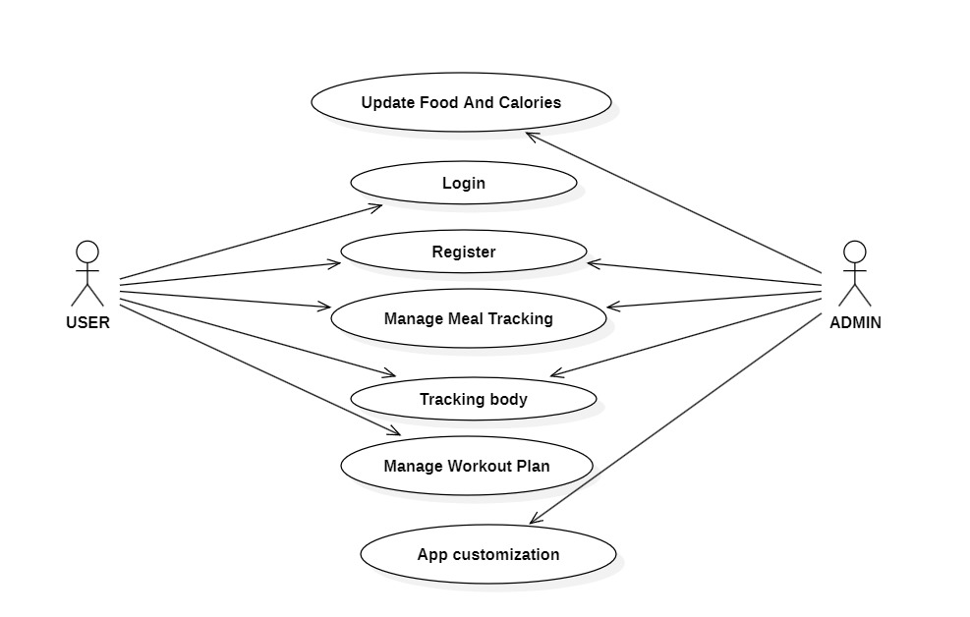
USE CASE DIAGRAM
Register
Login

Slide 12
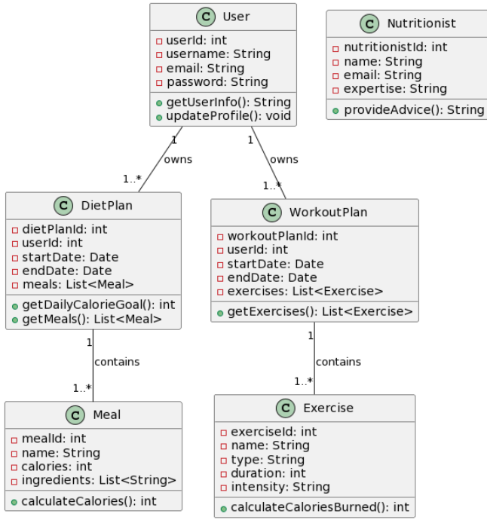
CLASS DIAGRAM

Slide 13
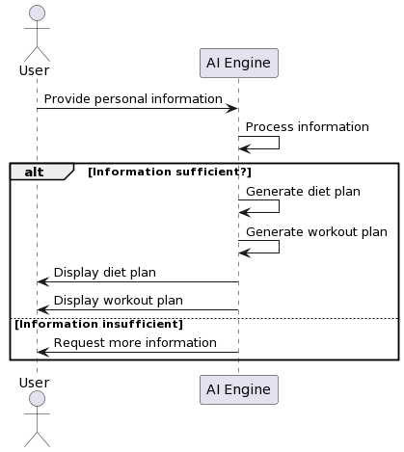
SEQUENCE DIAGRAM

Slide 14
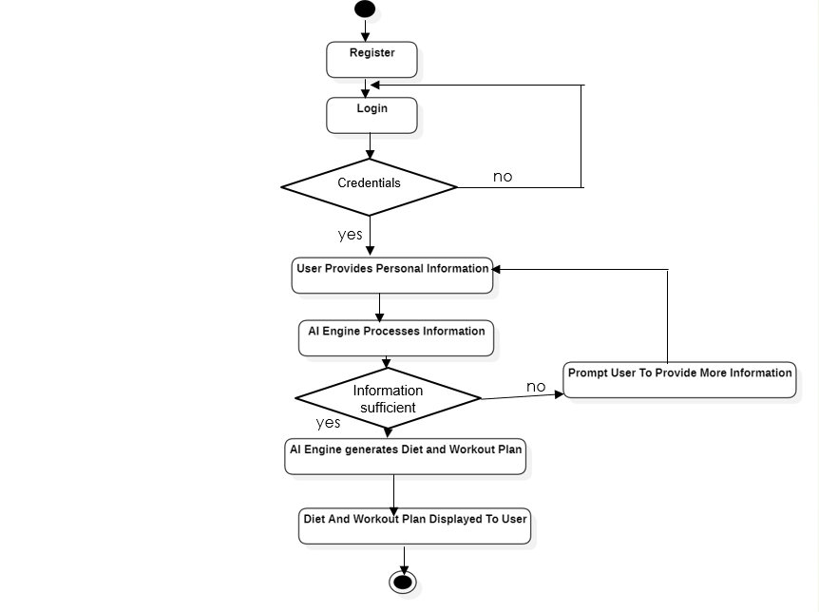
ACTIVITY DIAGRAM

Slide 15
References:
"Artificial Intelligence: A Guide to Intelligent Systems" by Michael Negnevitsky.:
"AI-Based Diet Recommendations: An Overview" by Sumit Gupta.
"Nutrition Informatics: Applications in Health Promotion and Disease Prevention" edited by Douglas J. Luke and Sean F. Altekruse.
"Python for Data Analysis" by Wes McKinney.
" MySQL " : W3schools SQL tutorial
" HTML" :W3schools HTML tutorial

Slide 16


